Slide 1






SCHOLAR AI
SCHOLAR AI
PITCH DECK
Explore Studio Shodwe's innovative technology solutions and their potential to drive transformation and growth in various industries

Slide 2





SCHOLAR AI
About Us
Scholar AI is dedicated to making your study abroad experience seamless and rewarding. Our platform offers personalized recommendations for schools and programs tailored to your interests and budget. We also provide insights into scholarship opportunities and the visa application process, ensuring you have all the resources you need for success.

Slide 3






SCHOLAR AI
Meet team
LEAD
RYAN
DESIGNER
BUNBOZ
DEV
DAVID
MARKETING
DAISY

Slide 4


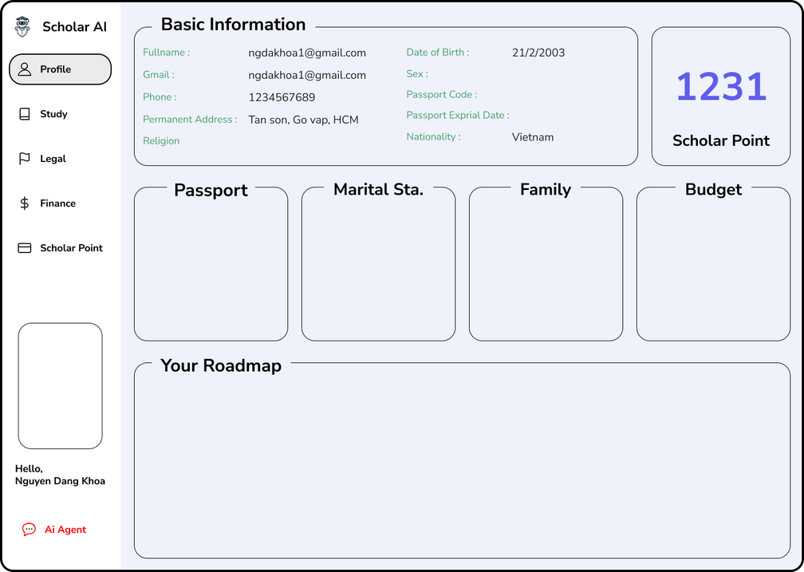
SCHOLAR AI
Profile
users provide input, building a detailed database that enhances AI search accuracy by up to 40%. Personal data is rigorously protected, ensuring no third-party sharing. We empower users with data control, distinguishing us from invasive data collection systems. AI deeply understands each user's needs, delivering a trusted, optimal experience. Our internal studies show 90% user satisfaction with our security measures.

Slide 5

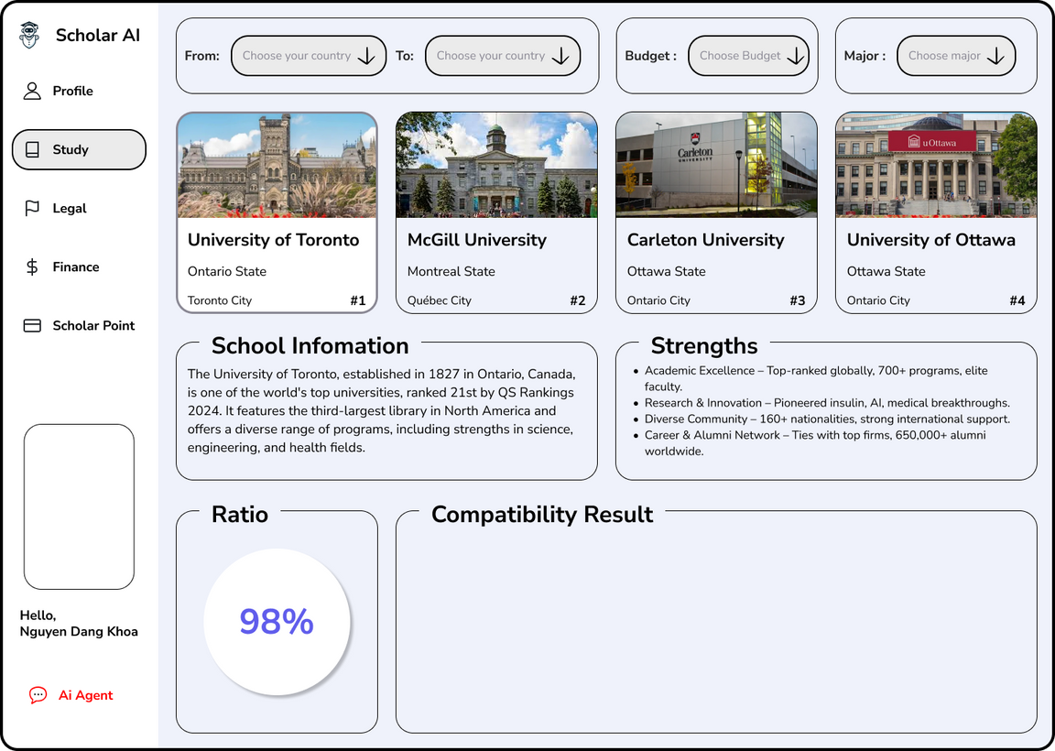
SCHOLAR AI
Study
AI analyzes profiles, increasing acceptance rates by 30%, achieving 70% compared to 40% with traditional applications. This means, with 'Study', your chances of getting into your desired school nearly double. Saves 50% search time, equivalent to 10 research hours per person, reduced from 20 hours. Instead of spending weeks searching websites, 'Study' compiles and analyzes data in minutes. The system filters out 90% of irrelevant information, helping you focus on the most promising options. This eliminates unsuitable schools early, saving time and effort. On average, users save 20% on study abroad consulting fees, approximately 5 million VND. Instead of paying for expensive consulting services, 'Study' provides comprehensive information and guidance, empowering you to make confident decisions.

Slide 6
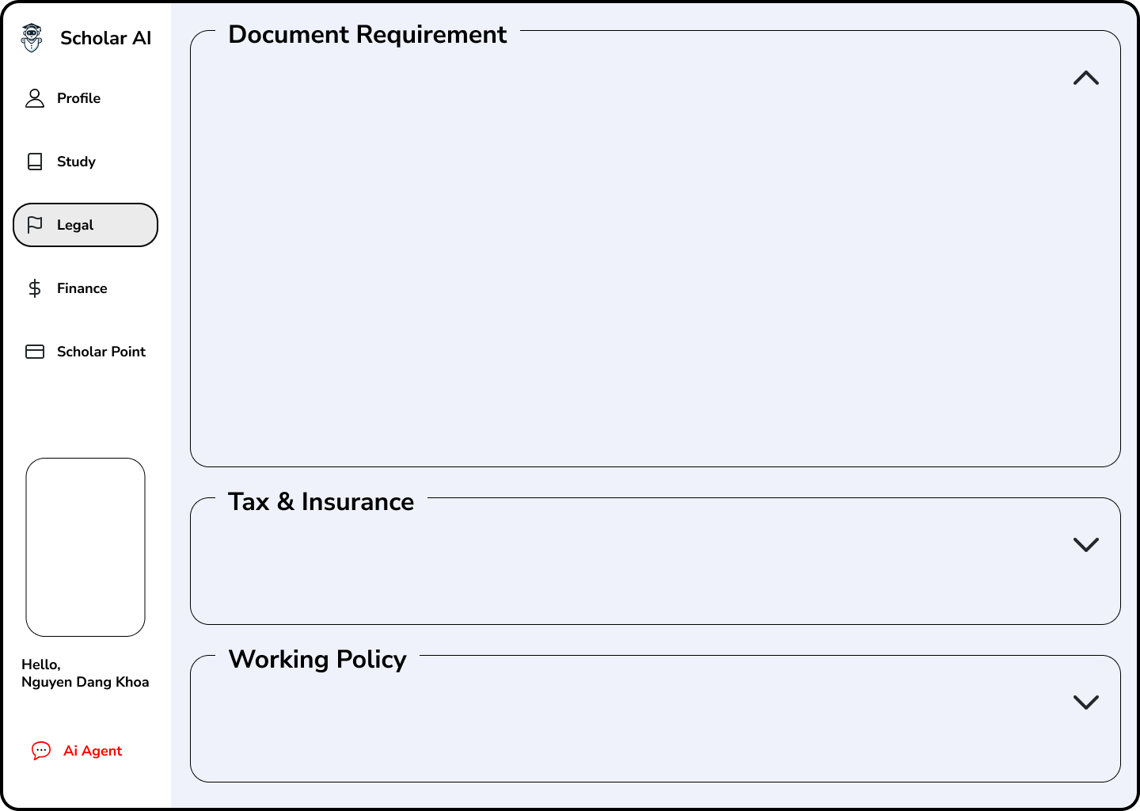
SCHOLAR AI
Legal
Your AI-powered guide to seamless study abroad preparation. By integrating data from your 'Profile' and 'Study' tabs, our AI generates a personalized document checklist, ensuring you never miss a critical requirement. Beyond documentation, AI provides up-to-date insights into tax and insurance policies, empowering you with crucial financial foresight. Navigate complex legal landscapes with ease, as AI delivers clear guidance on work permit regulations across your chosen countries and regions. With 'Legal,' AI transforms daunting legal hurdles into manageable steps, ensuring a confident and informed study abroad journey

Slide 7
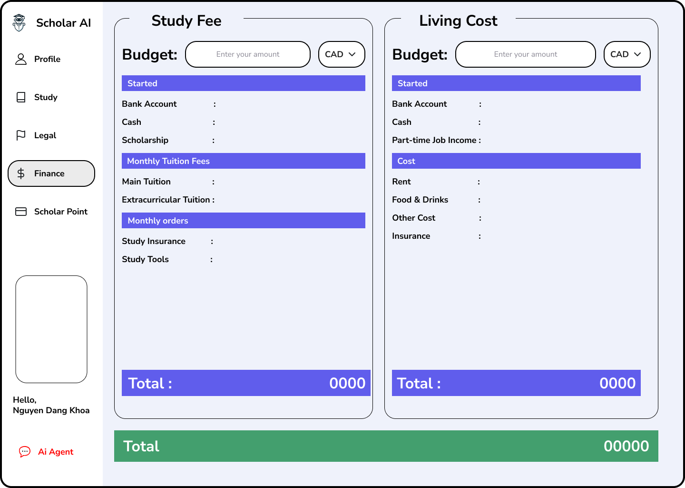
SCHOLAR AI
Finance
AI analyzes study abroad profiles, creating personalized tuition and living cost plans based on data from Profile, Study, and Legal. Users input their budget, and AI suggests multiple suitable options. Increases cost estimation accuracy by 40% compared to manual methods, reducing financial errors. Saves 30% planning time, completed in minutes. AI updates exchange rates and financial policies in real-time, reducing financial risks by 25%. The AI application helps users compare costs between schools and countries, find scholarships, optimize budgets, and make informed study abroad financial decisions.

Slide 8
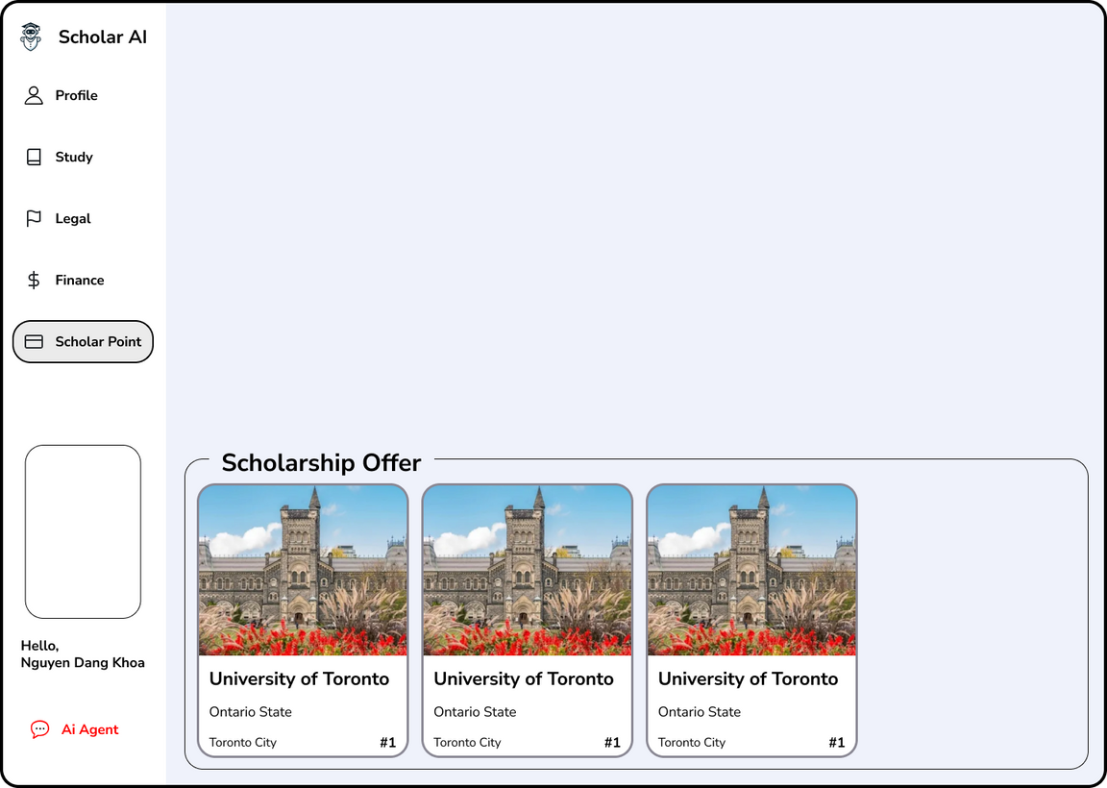
SCHOLAR AI
Scholar Point
Scholar Point is a unique rewards system designed to incentivize and recognize user efforts throughout their study abroad journey. Users earn points through application engagement, friend referrals, and milestone achievements like university acceptance. Points can be redeemed for online soft skills courses from reputable partners, in-depth statistical reports on study fields or countries, and one-on-one consultations with successful study abroad alumni. Scholar Point fosters a supportive community and provides valuable resources, enhancing the overall user experience. This system motivates users, promotes skill development, and facilitates informed decision-making, empowering them to achieve their academic and career aspirations.

Slide 9
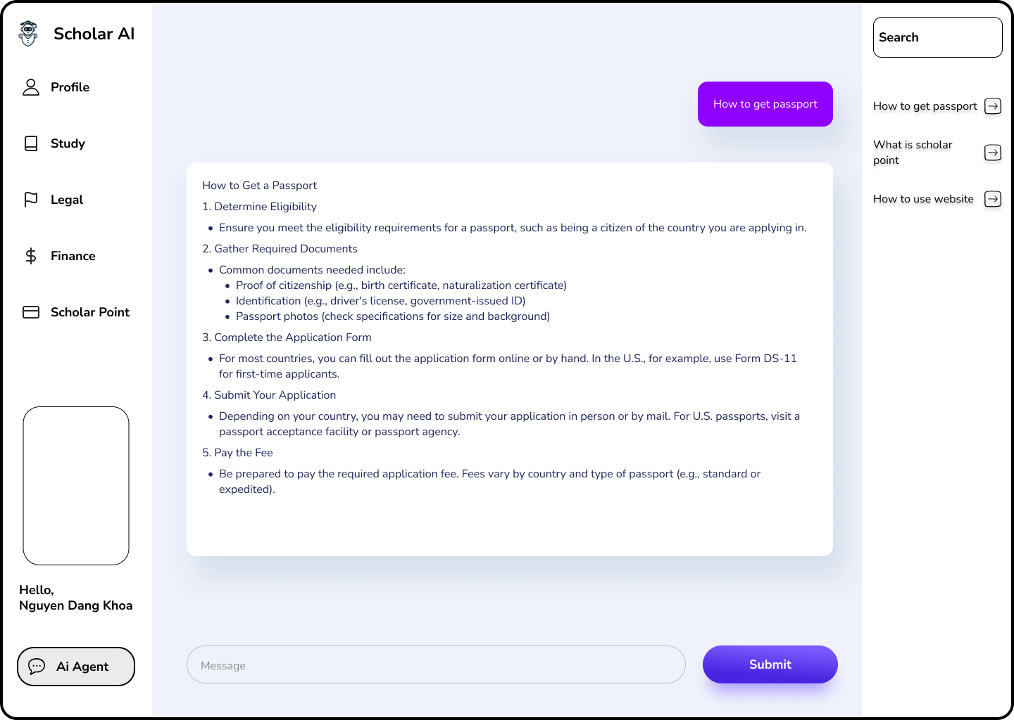
SCHOLAR AI
AI Agent
1. Automated Profile Management:
Our AI aggregates and updates your profile information from various sources, ensuring accuracy and completeness. Users can request customized profile summaries, saving valuable time.
2. AI-Driven Document Assistance:
The AI auto-fills essential information, providing draft documents for review and editing. This streamlines the application process and minimizes errors.
3. Specialized CV Support:
AI analyzes your skills and experience to generate tailored CV templates. It assists in crafting compelling job descriptions and skill summaries, enhancing your CV's impact.
4. Proactive Course Application:
AI identifies skill gaps and recommends relevant courses. It can automate course applications or provide optimal course selections.

Slide 10

SCHOLAR AI
THANK YOU!
Get in Touch With Us

